Slide 1
Gameday & Supportive Feedback
LO IWBAT Play interactive games.
Evaluate the experience.

Slide 2
Learning ObjectiveS:
To:
Play interactive games created by peers
Evaluate game and provide supportive peer feedback
Notes:
Students prior knowledge: essential structure of p5-js, creating a canvas, vocabulary words to support basic p5-js structure: function, lines of code, syntax, parameters, values, commands

Slide 3

Game
Day
With a partner, decide on a game to play from our class’ game board.
    Play each game 2x
    1st round: just play
    2nd round: evaluate
Notes:
Click present to view each paragraph in a visually friendly way.

Slide 4
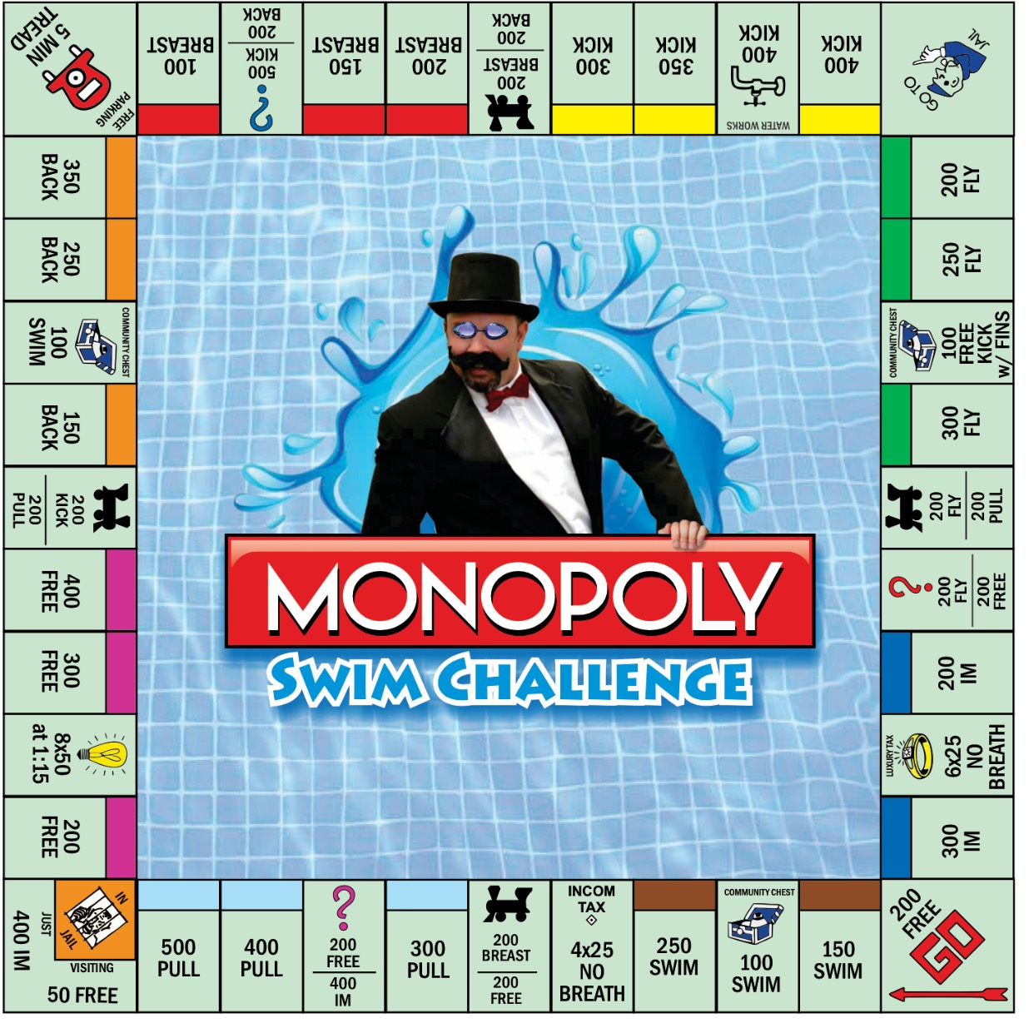
Game
Day
Select an icon. Click the hyperlink to play
Class Game boards here
Icon and hyperlink are attached as well.
Notes:
Once each game is complete, students or teacher will create an icon and hyperlink. Place it on a section of the board. Board is shared on Google Classroom as viewable. (use https://docs.google.com/presentation/d/1aakB0hPBNYyHinB7ZMd8HJ8roJELL2Y2cHxYU4bUgtE/view#slide=id.g1080225c057_2_17)

Slide 5
Game Board Evaluated #1: _________
How many times did you play the game?
What positive attributes do you notice about the game?
What modifications have you detected in the game?
What suggestions do you have to make the game more successful?
Leave a positive note!
Notes:
Students will evaluate three games.

Slide 6
Game Board Evaluated #2: _________
How many times did you play the game?
What positive attributes do you notice about the game?
What modifications have you detected in the game?
What suggestions do you have to make the game more successful?
Leave a positive note!

Slide 7
Game Board Evaluated #3: _________
How many times did you play the game?
What positive attributes do you notice about the game?
What modifications have you detected in the game?
What suggestions do you have to make the game more successful?
Leave a positive note!

Slide 8
End of Unit

